Slide 1
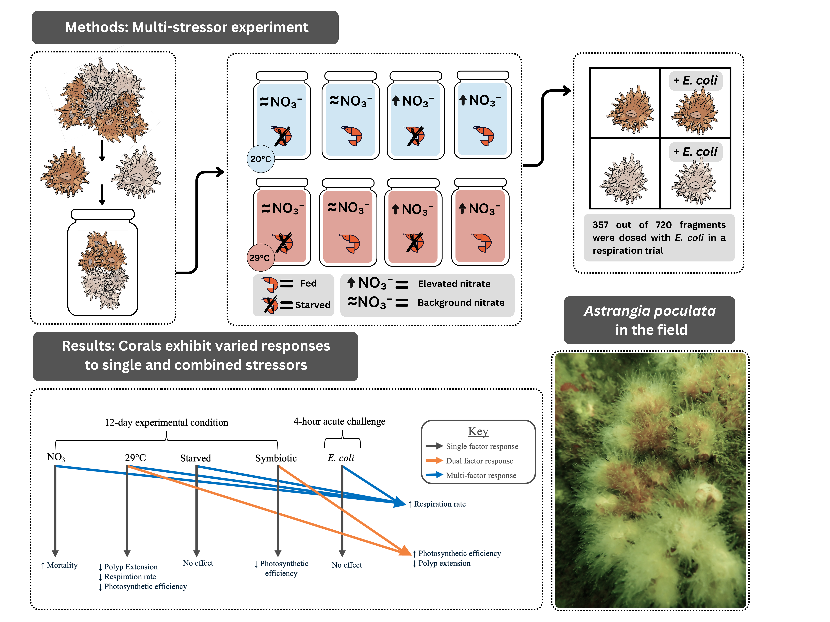

Slide 2
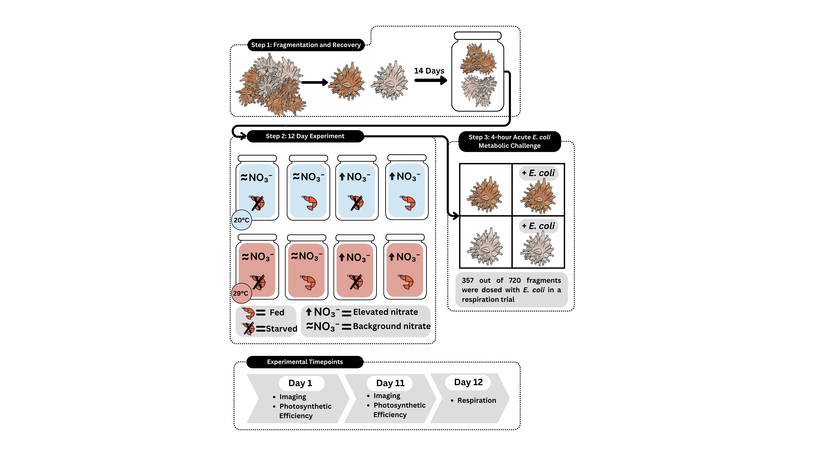

Slide 3
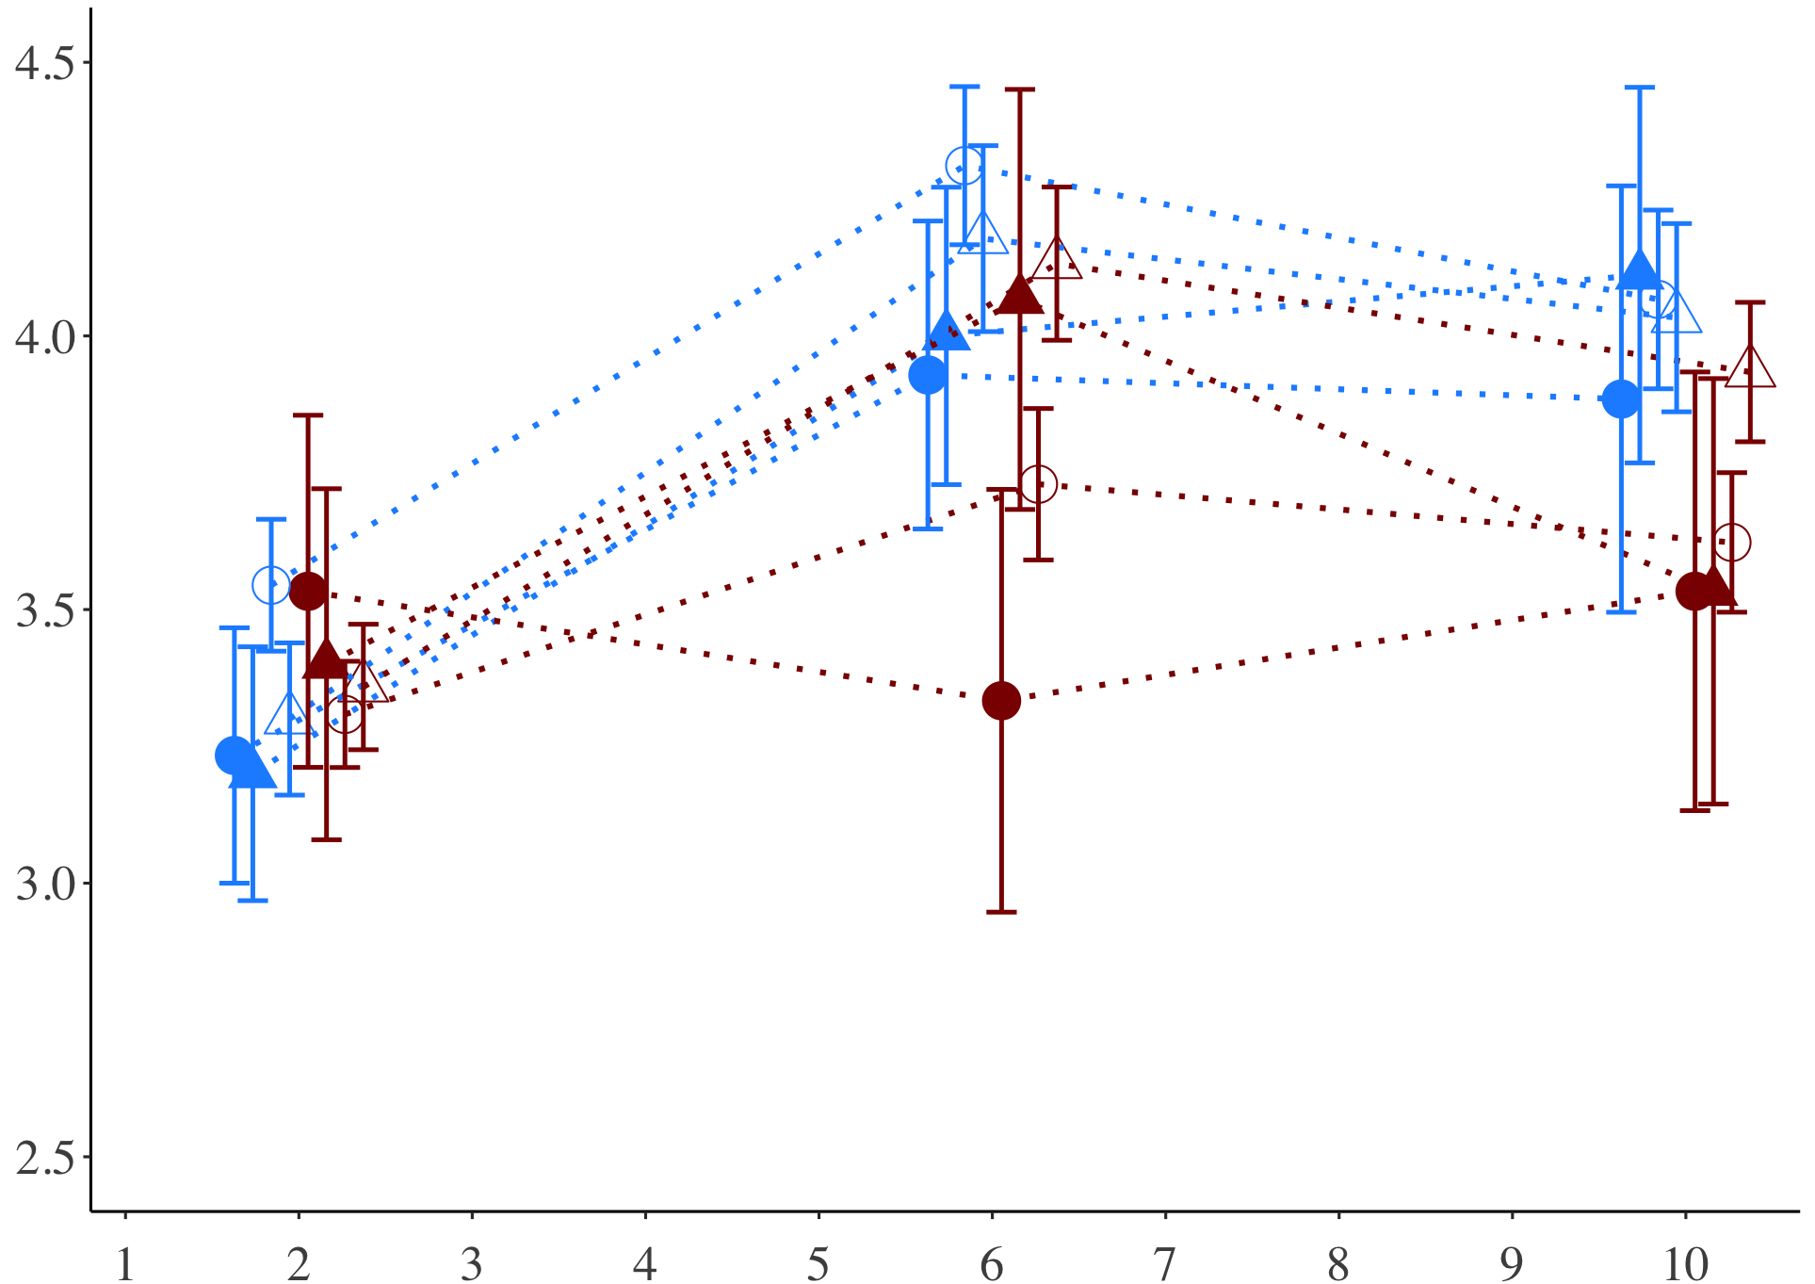
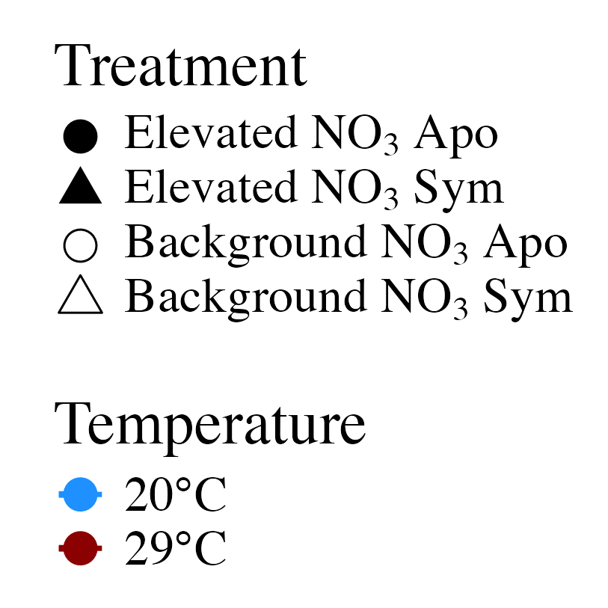
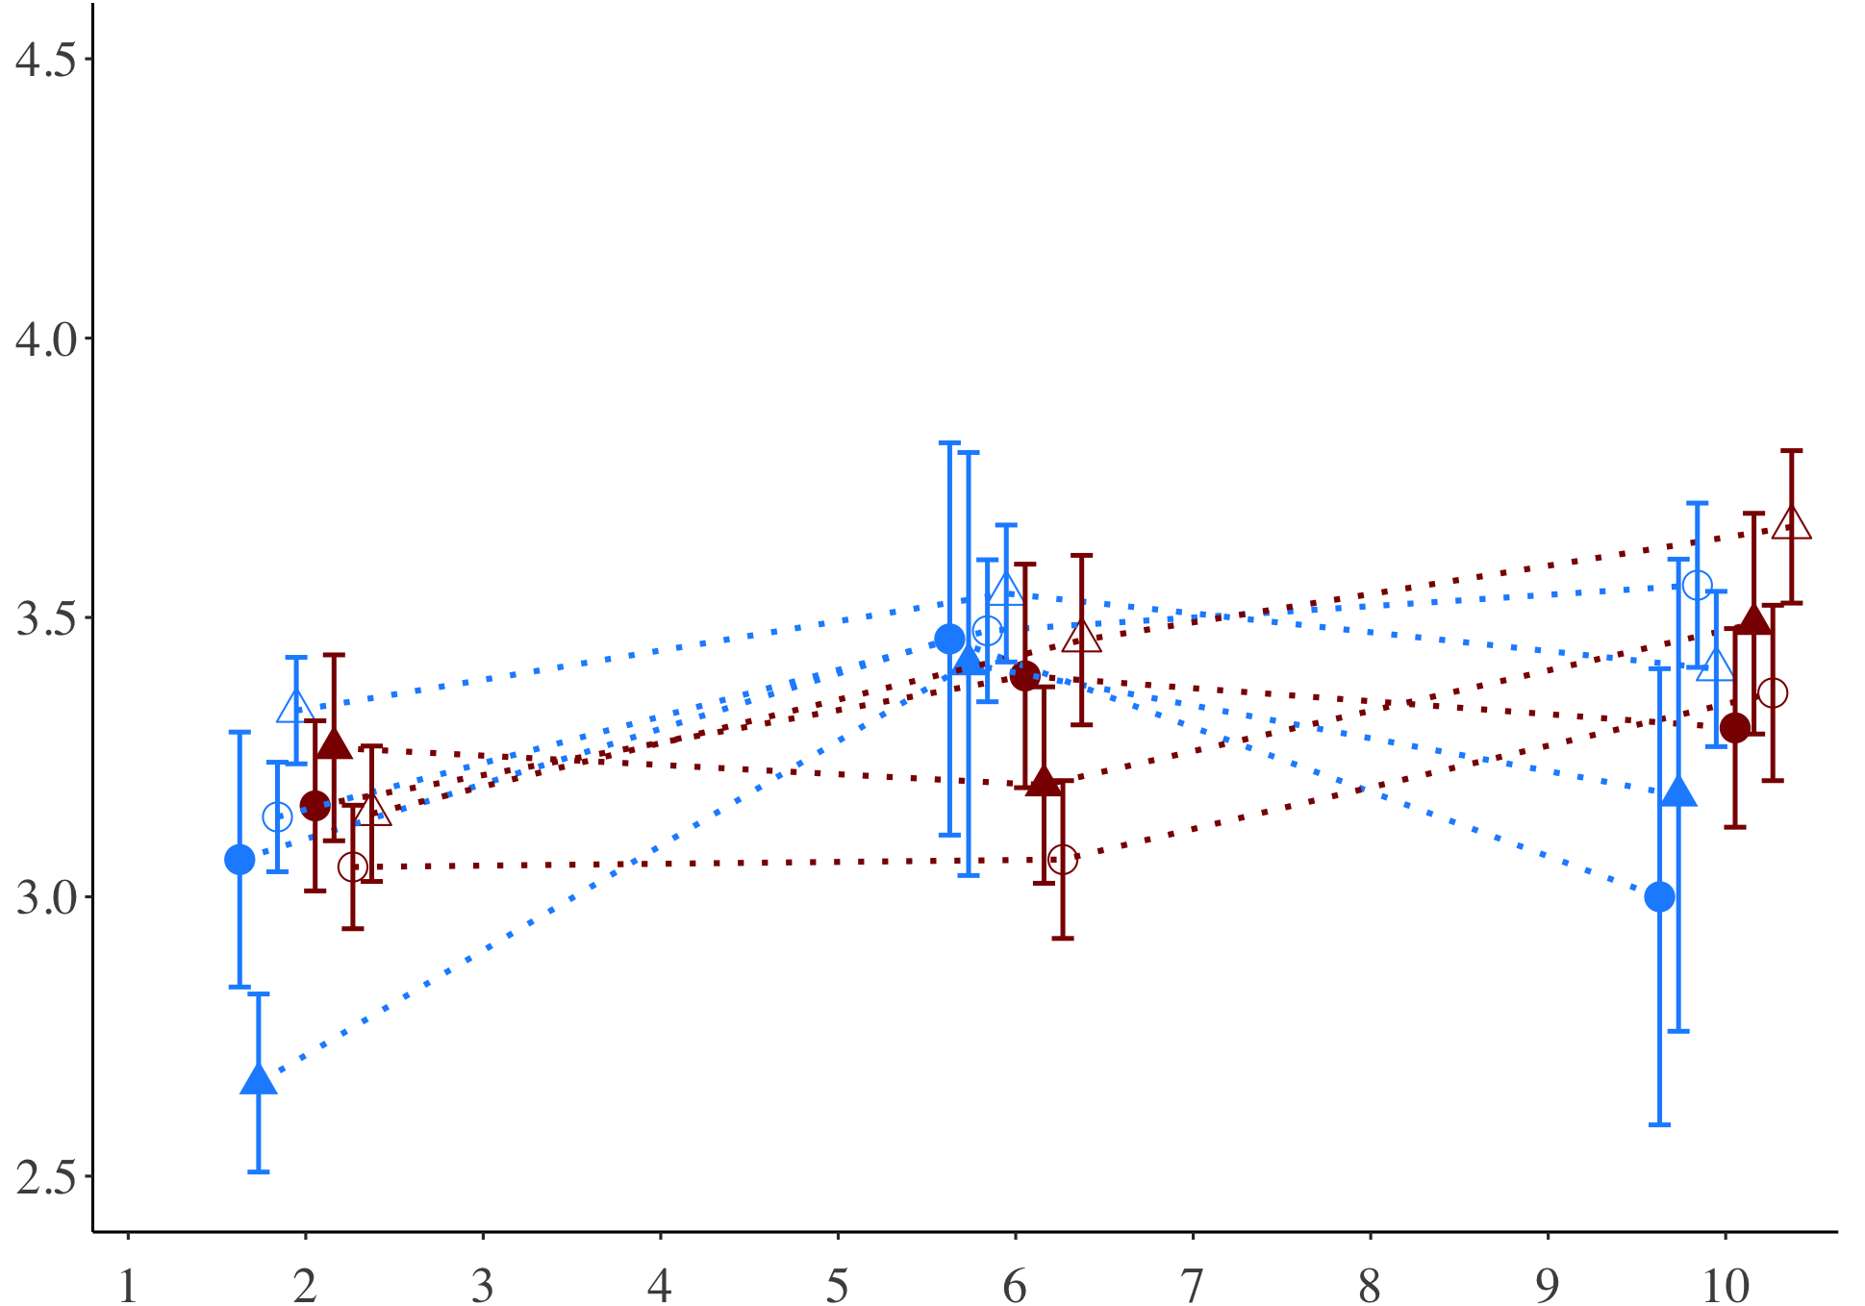
A) Fed
Average polyp extension score
B) Starved
Day of experiment

Slide 4
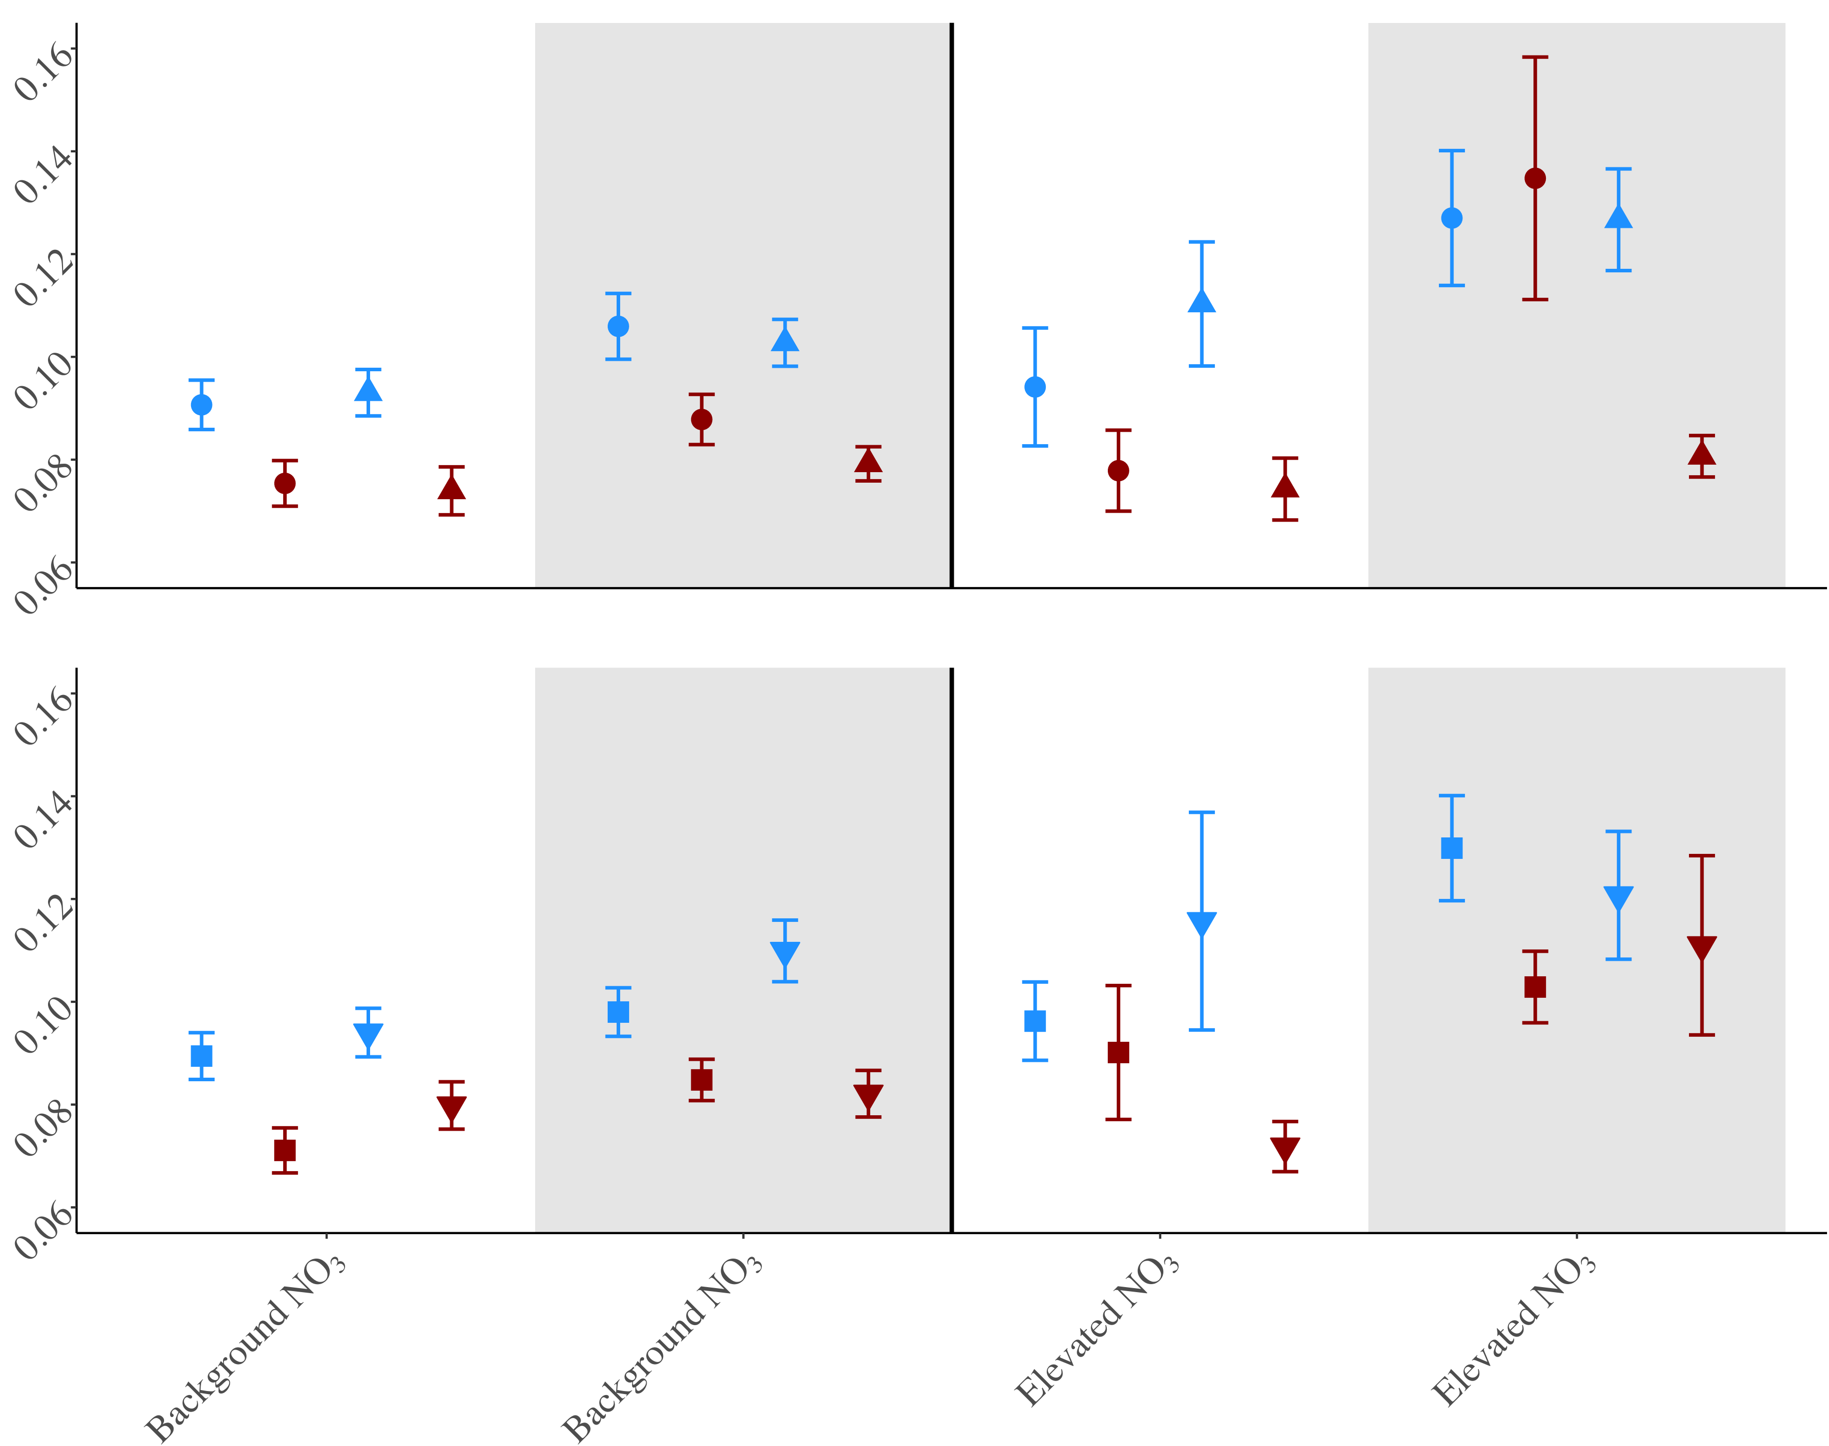
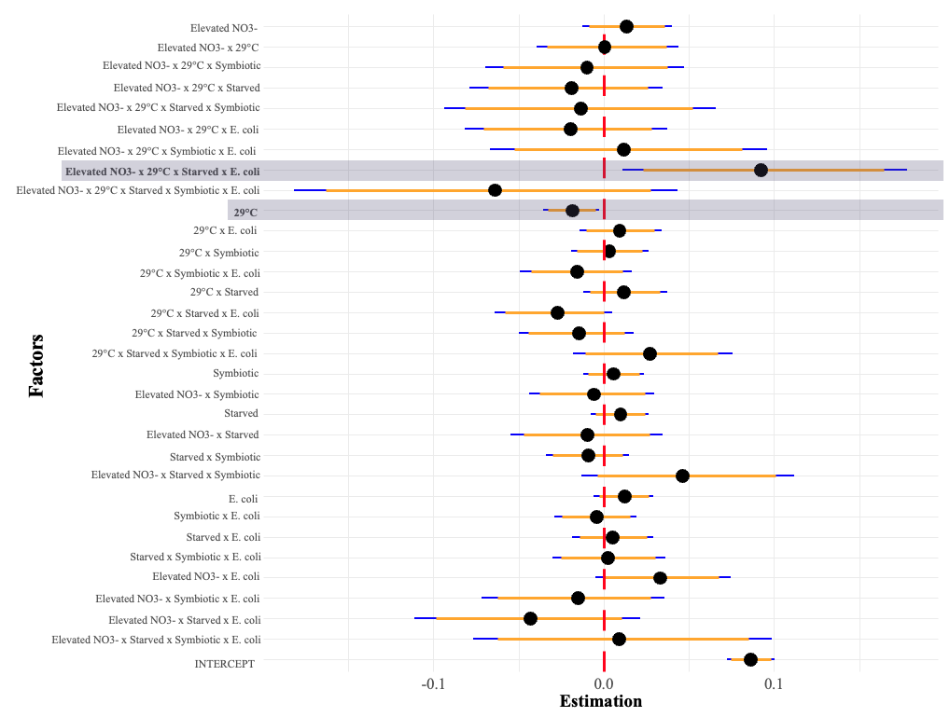
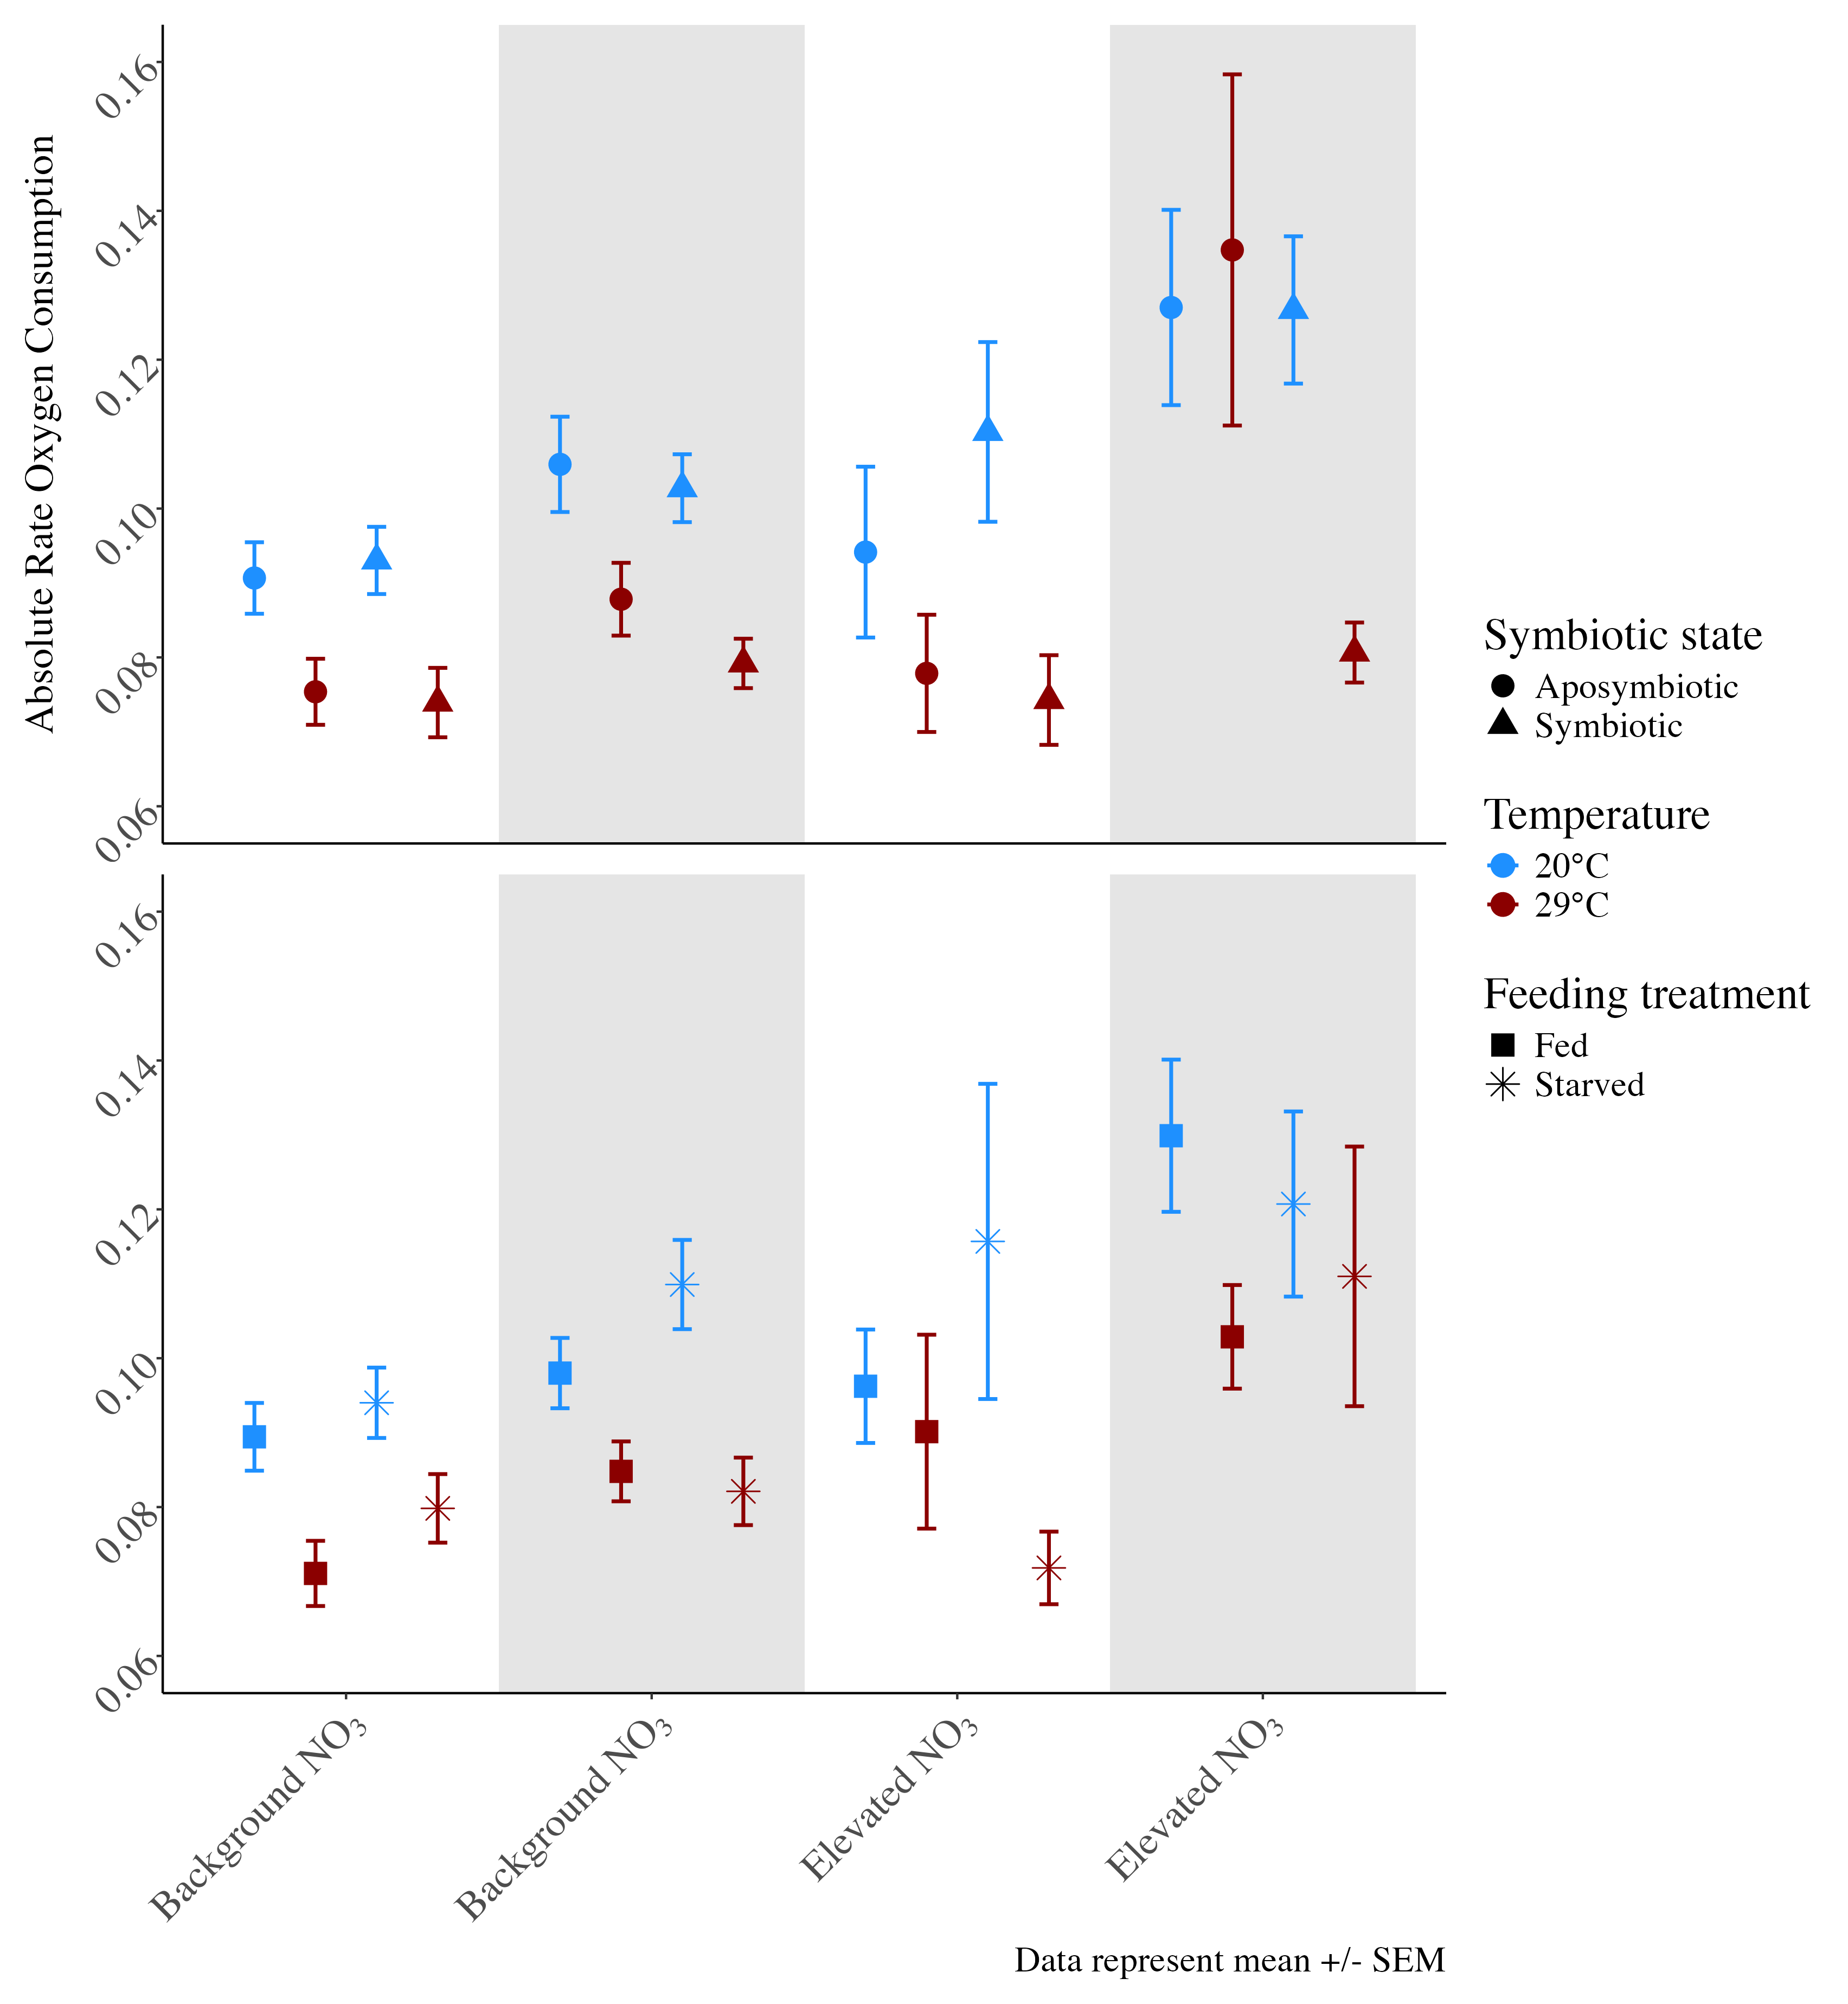
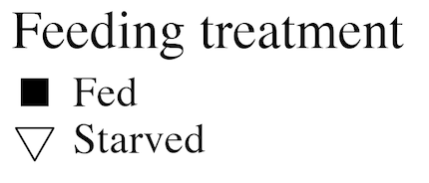
Symbiotic state: symbiotic vs. aposymbiotic
E) Bayesian Coefficients
A)
B)
Absolute rate O₂ consumption (µmol/min/cm²)
Feeding treatment: fed versus starved
B) Feeding treatment: fed versus starved
C)
D)
Background NO₃
Elevated NO₃
E. coli challenge
No E. coli
E. coli

Slide 5
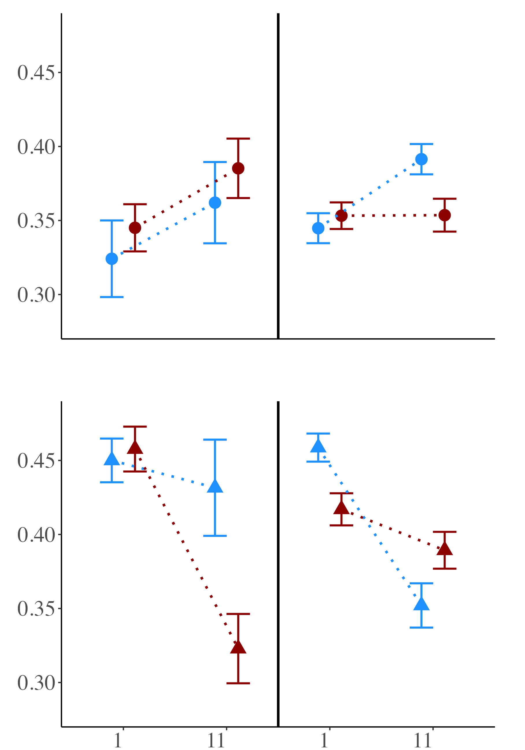
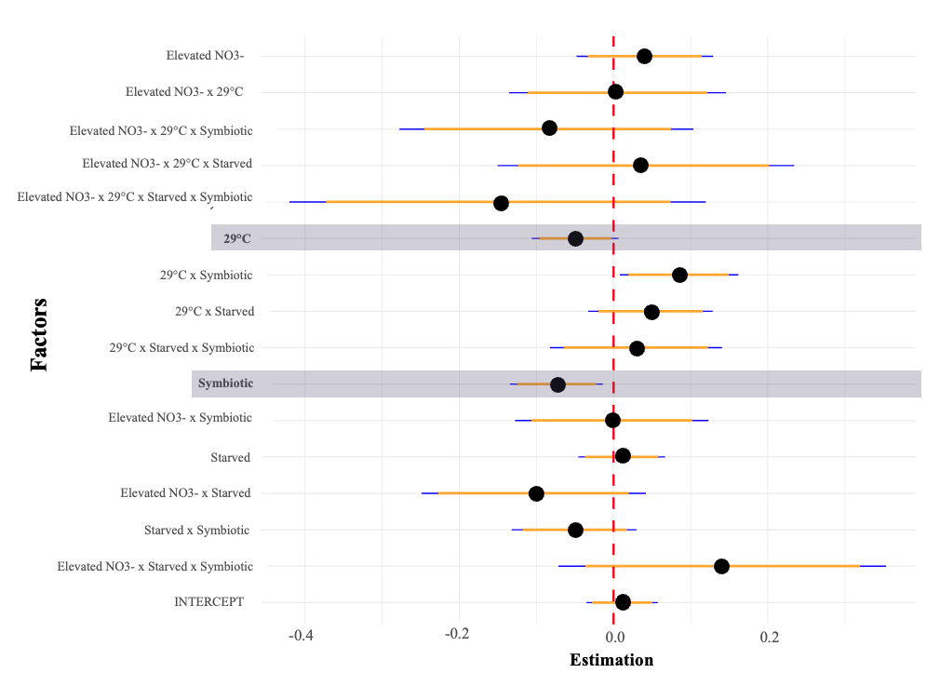
Aposymbiotic corals
A)
B)
E)
Symbiotic corals
Photosynthetic efficiency (Fv/Fm)
C)
D)
Background NO₃
Elevated NO₃
Notes:
25

Slide 6
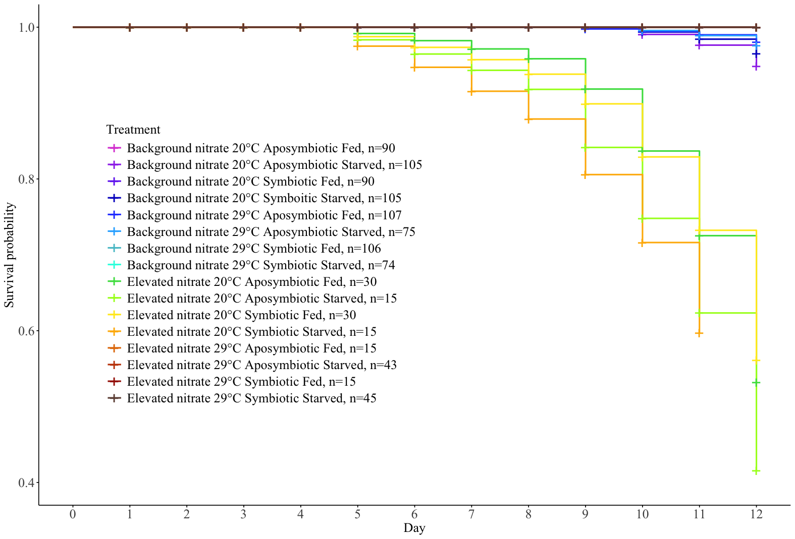
Nitrate Level | Temper -ature | Symbiotic State | Feeding status | Sample size | Color
Background | 20 | Aposymbiotic | Fed | 90
Background | 20 | Aposymbiotic | Starved | 105
Background | 20 | Symbiotic | Fed | 90
Background | 20 | Symbiotic | Starved | 105
Background | 29 | Aposymbiotic | Fed | 107
Background | 29 | Aposymbiotic | Starved | 75
Background | 29 | Symbiotic | Fed | 106
Background | 29 | Symbiotic | Starved | 74
Elevated | 20 | Aposymbiotic | Fed | 30
Elevated | 20 | Aposymbiotic | Starved | 15
Elevated | 20 | Symbiotic | Fed | 30
Elevated | 20 | Symbiotic | Starved | 15
Elevated | 29 | Aposymbiotic | Fed | 15
Elevated | 29 | Aposymbiotic | Starved | 43
Elevated | 29 | Symbiotic | Fed | 15
Elevated | 29 | Symbiotic | Starved | 45
Notes:
Gray background for 29, black background white text for Elevated

Slide 7
12-day experimental condition
4-hour acute challenge
NO₃
29°C
Starved
Symbiotic
E. coli
Key
Single factor response
Dual factor response
Multi-factor response
↑ Respiration rate
↑ Photosynthetic efficiency
↓ Polyp extension
↑ Mortality
↓ Polyp Extension
↓ Respiration rate
↓ Photosynthetic efficiency
No effect
↓ Photosynthetic efficiency
No effect

Slide 8
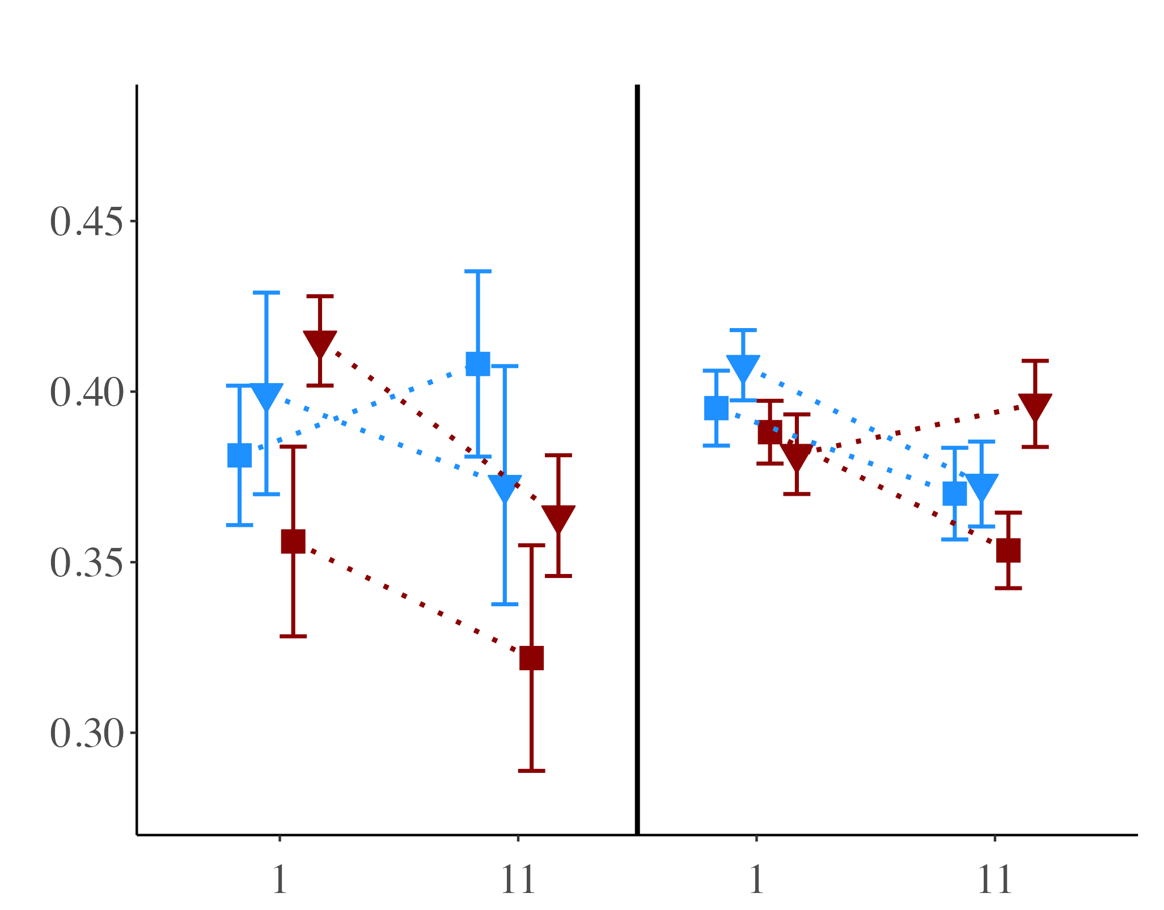
Photosynthetic efficiency (Fv/Fm)
A)
B)
Background NO₃
Elevated NO₃
Notes:
25

Slide 9
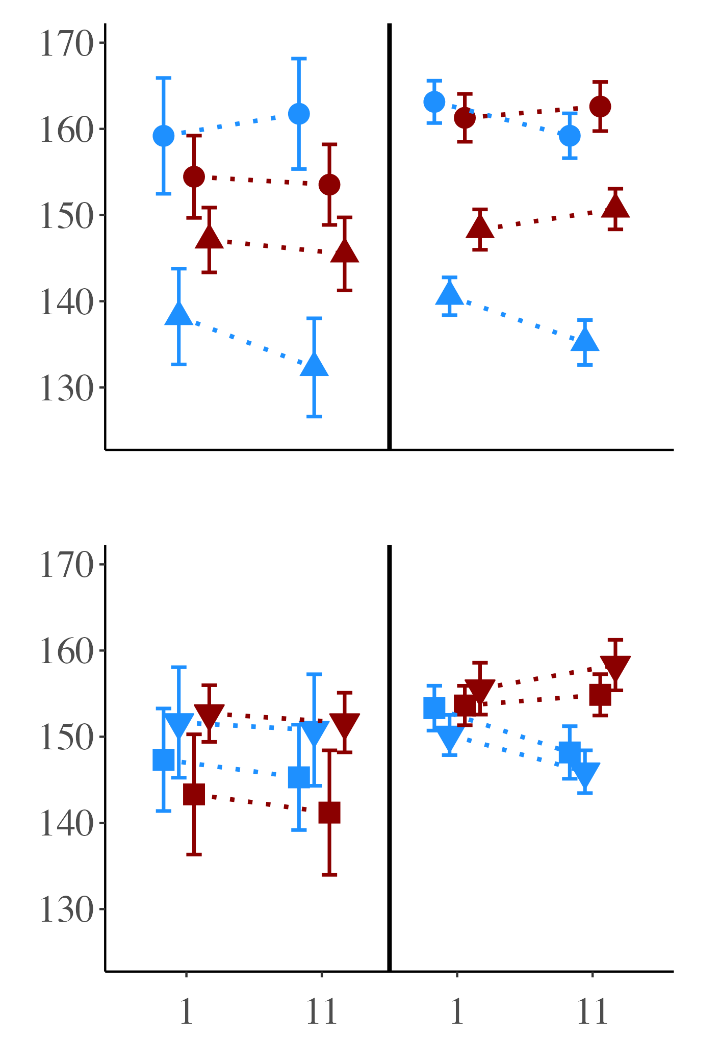
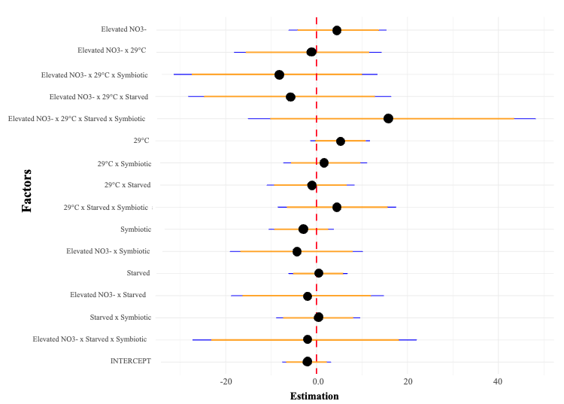
Symbiotic state: symbiotic vs. aposymbiotic
A)
B)
E)
Red Channel Value
Feeding treatment: fed vs. starved
C)
D)
Background NO₃
Elevated NO₃
Notes:
25

Slide 10
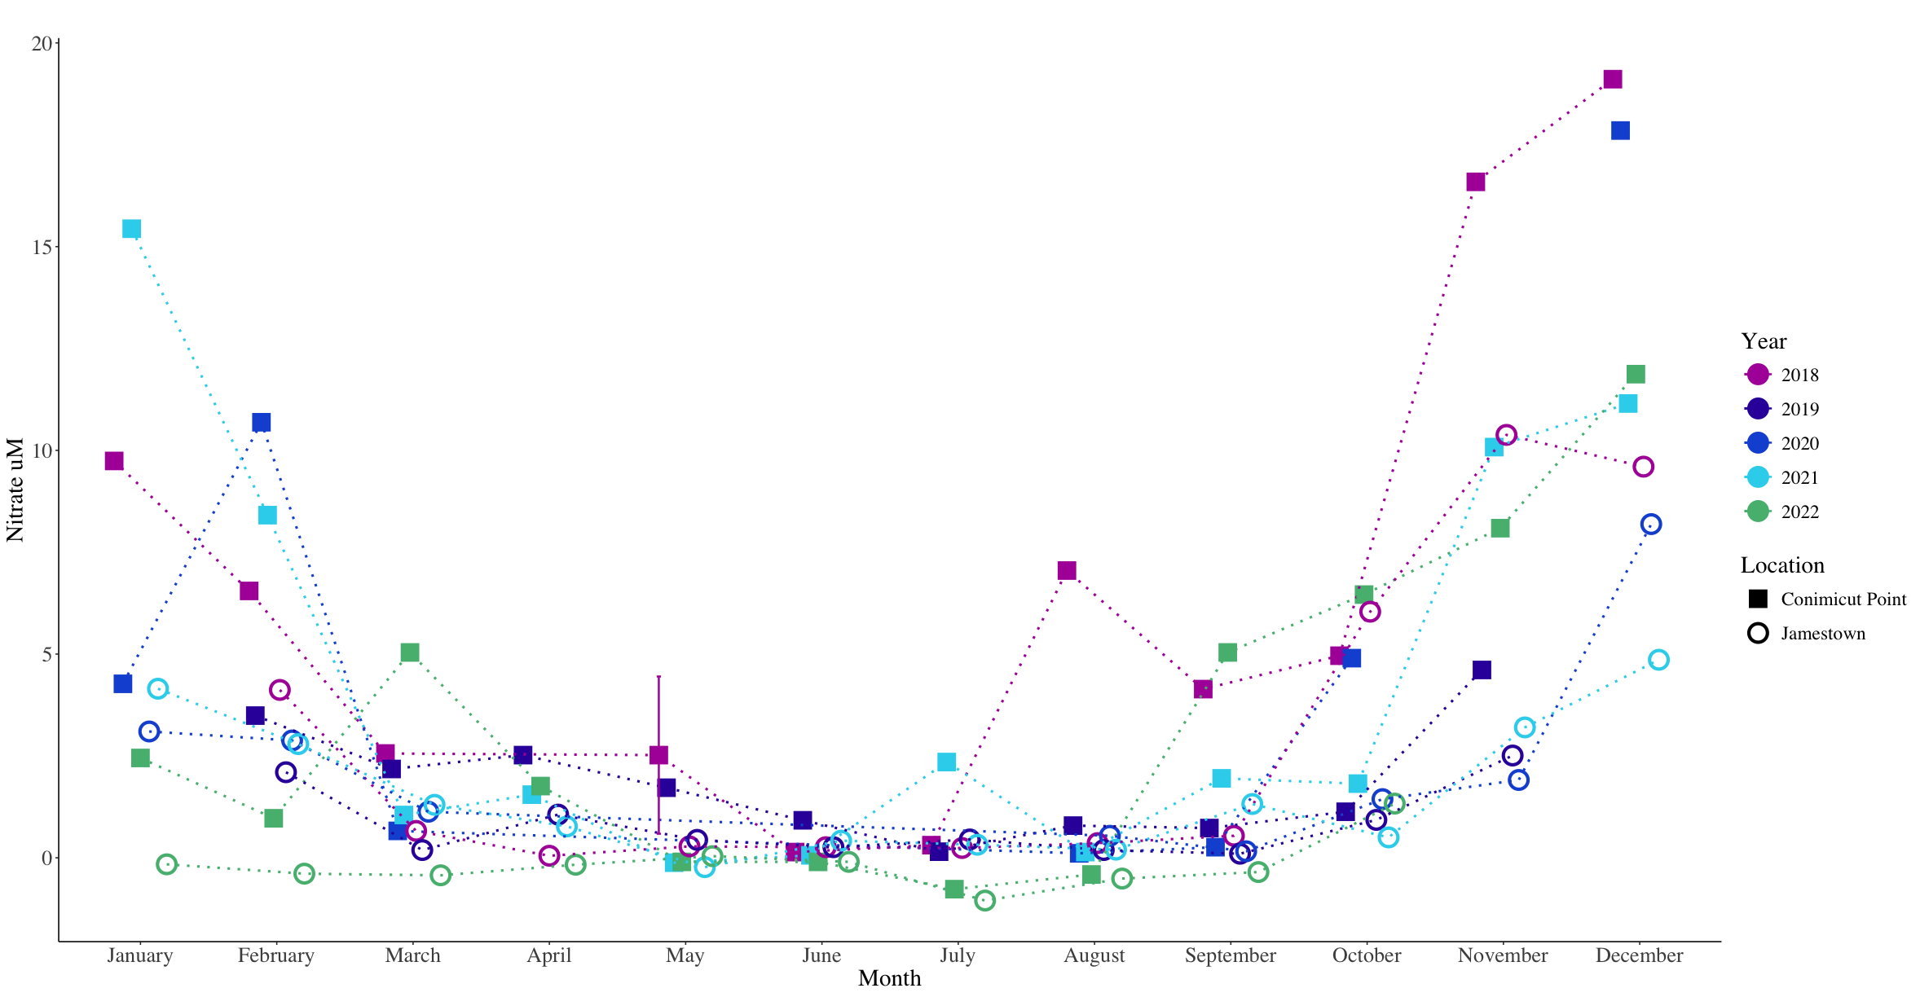

Slide 11
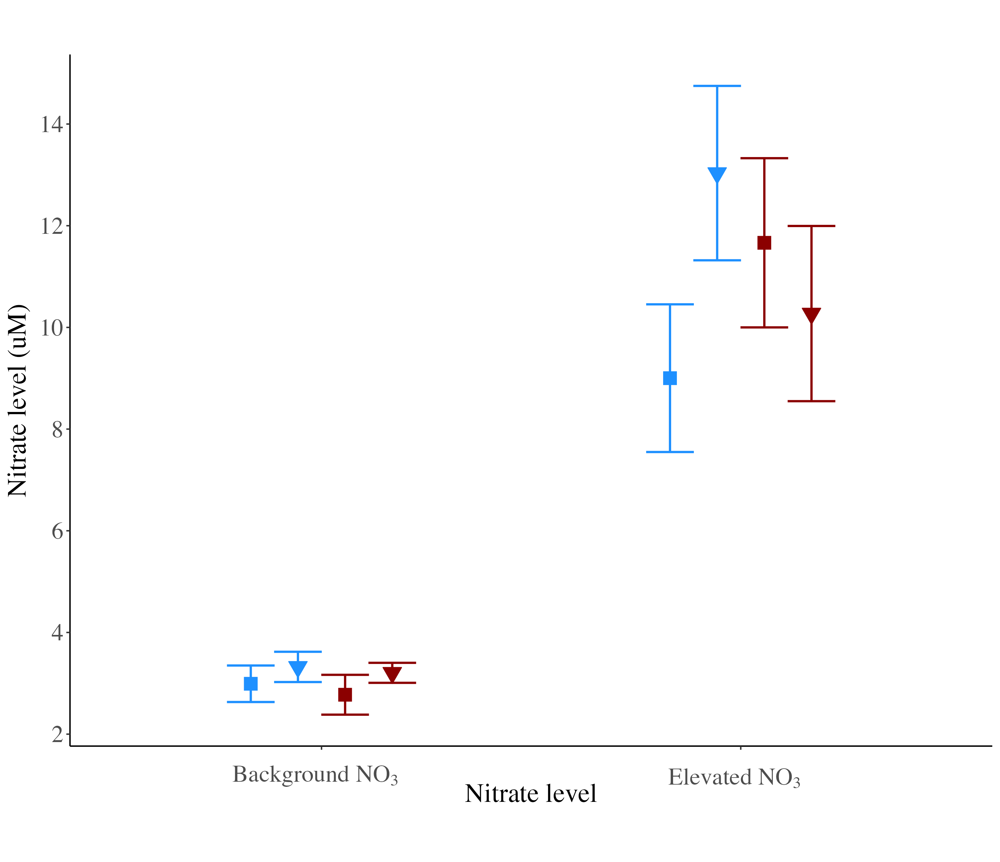

Slide 12
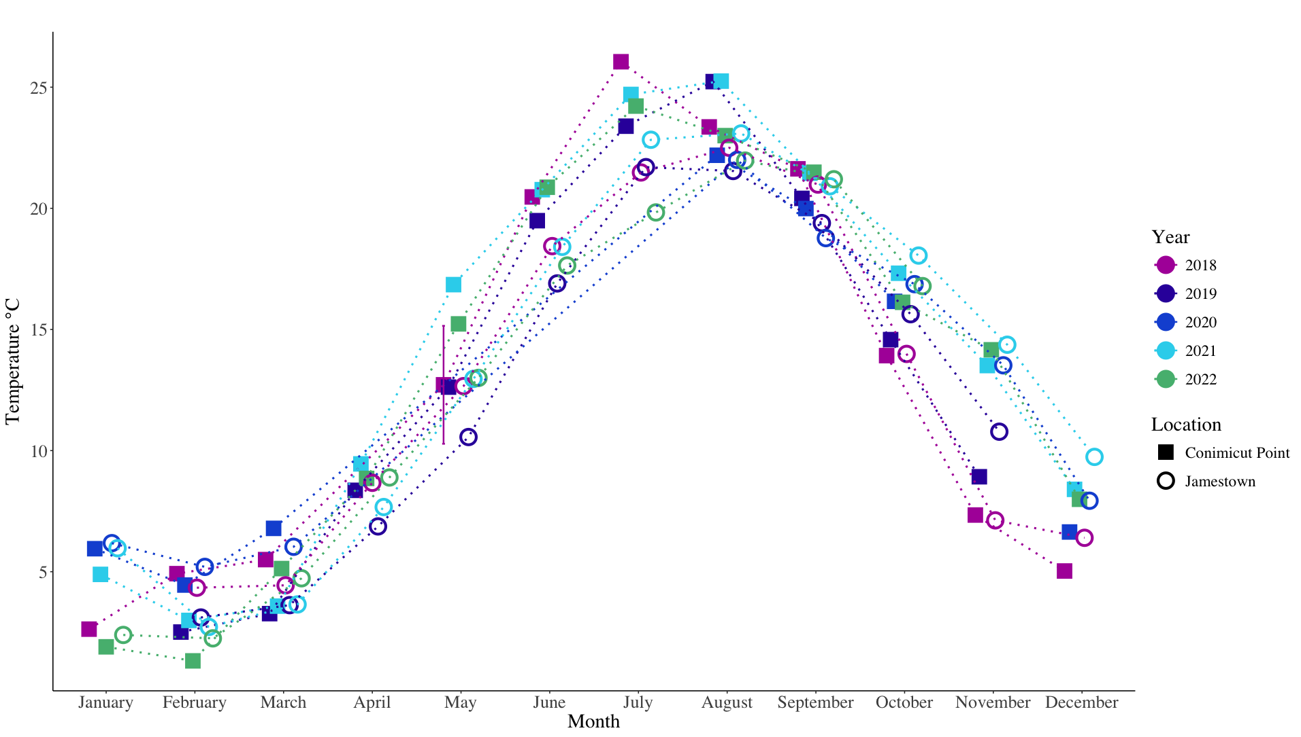

Slide 13
